Slide 1
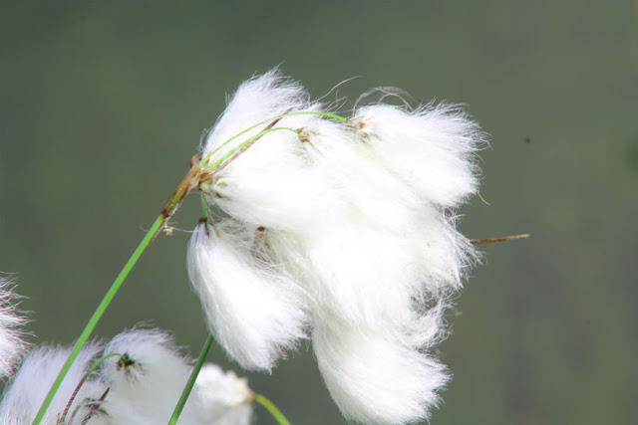
Kildare Climate Action Linkage Group Key Actions

Slide 2
Themes:
Water
Natural Resources & Cultural
Community Health & Wellbeing
Development, Transport & Built Environment
Transition to Low Carbon

Slide 3
Water
Water harvesting for public pitches, parks and gardens.
Sustainable Urban Drainage
Identify and designate Natural Flood Plains
Explore the use of natural water retention – liaise with OPW
Provide grant funding for community water harvesting projects and supply water butts at a reduced cost for households in Kildare.

Slide 4
Natural resources & Cultural
Plant native trees in conjunction with an awareness campaign to highlight the benefits of trees, i.e. improving air quality, promoting biodiversity, sequestration of carbon dioxide, limiting flood risk, reducing urban heat as well as their aesthetic benefits.
Reduced use of chemicals/spraying in Council areas.
Protect and enhance Green infrastructure through the protection and nurturing of existing natural ecosystems
Make provision for natural borders/buffers and include as integral component of the design of green/blue way, tracks, trails, amenity and tourism
Using the Kildare biodiversity plan, provide for actions that ensure all risks from adverse climate change have been identified and measures have been employed to address these.

Slide 5
Community Health & Wellbeing
For projects subject to funding and investment of public money, integrate climate change considerations as criteria for assessment.
Reduce single use plastics and increase awareness of refill.ie and conscious cup campaign.
Ban use of single use plastics in KCC buildings, libraries and council managed or supported events.
Ban sky lanterns and balloons.
Through the PPN, raise awareness of Climate Change and the need for mitigation.
Work with Kildare Leader Partnership to identify funding streams available to enable local climate action projects.
Encourage and incentivise local food production – establish or facilitate markets and provide grants or funding for local food businesses to reduce food miles.

Slide 6
Development, Transport & Built Environment
Develop infrastructure for cycle lanes, walking paths, amenity trails, and links to existing greenways and blueways, new greenways and blueways.
Develop bicycle parking infrastructure throughout the county.
Promote modal shift from private car ownership to alternative transport e.g. car sharing initiatives, bike sharing initiatives.
County council coordination of car and bike sharing initiatives.
Development of serious public transport system that competes successfully with private car transport.

Slide 7
Development, Transport & Built Environment cont.
Develop Climate Change Awareness Campaign for business and start-ups to inform of climate action measures that can be integrated into business activities.
Develop a sustainable urban and rural plan, use incentivisation and supportive policy to enhance climate action and control standards/criteria to enhance climate action, develop clean tech hub in Kildare.
Support the development of co-working hubs that work towards reducing the carbon footprint of local communities.
Housing – ensure new housing is correctly located and ensure that it’s not impinging on water resources or natural areas of conservation and that it is laid out within the context of adaptation to climate change.

Slide 8
Transition to low carbon
Work with SEAI and mentors to support existing Sustainable Energy Communities in County Kildare and encourage sustainable energy systems, promote energy efficiency, use renewable energy and develop decentralised energy supplies.
Encourage more communities to establish Sustainable Energy Communities and actively pursue projects to reduce energy consumption.
Rollout of EV charging infrastructure on KCC sites and private sites via supportive policy and control standards of the County Development Plan.
Research and map areas considered beneficial for use as local carbon offset through carbon sequestration and include in Green Infrastructure Strategy

